Slide 1
Understanding and Utilizing Deep Neural Networks Trained with Noisy Labels
李晓宇
2020.9.14
ICML 2019， https://arxiv.org/abs/1905.05040

Slide 2
Two Main Contribution
Theoretically relating the generalization performance of DNNs to the label noise
Test accuracy can be quantitatively characterized in terms of the noise ratio in datasets.
The test accuracy is a quadratic function of the noise ratio in the case of symmetric noise
Practical algorithms of selecting clean labels and training noise-robust DNNs
We apply cross-validation to randomly split noisy datasets, which identifies most samples that have correct labels. Then we adopt the Co-teaching strategy which takes full advantage of the identified samples.

Slide 3
Motivation
To utilize extensive noisy data, understanding how noisy labels affect training and generalization of DNNs is the very first step, based on which we can design specific methods to train DNNs robustly in practical applications.
In Zhang et al. (2017), it has been empirically found that the generalization performance of DNNs is highly dependent on the noise ratio.
In this paper, to quantitatively clarify the generalization performance of DNNs normally trained with noisy labels.

Slide 4




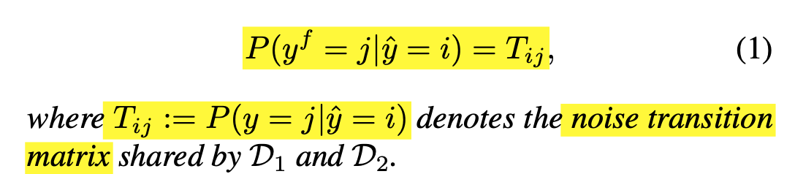
Generalization in distribution
In cross-validation, we randomly divide a noisy dataset D into two halves D1 and D2.
The network trained on D1 and tested on D2, we have:
-> Confusion matrix always matches noise transition matrix.

Slide 5
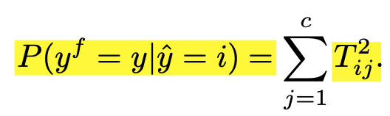
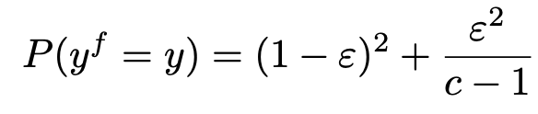
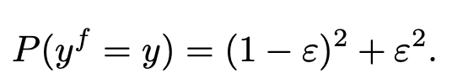
Further proposition and corollary
Test accuracy: (training on D1 and testing on D2)
For symmetric noise of ratio ε, the test accuracy is
For asymmetric noise of ratio ε, the test accuracy is

Slide 6
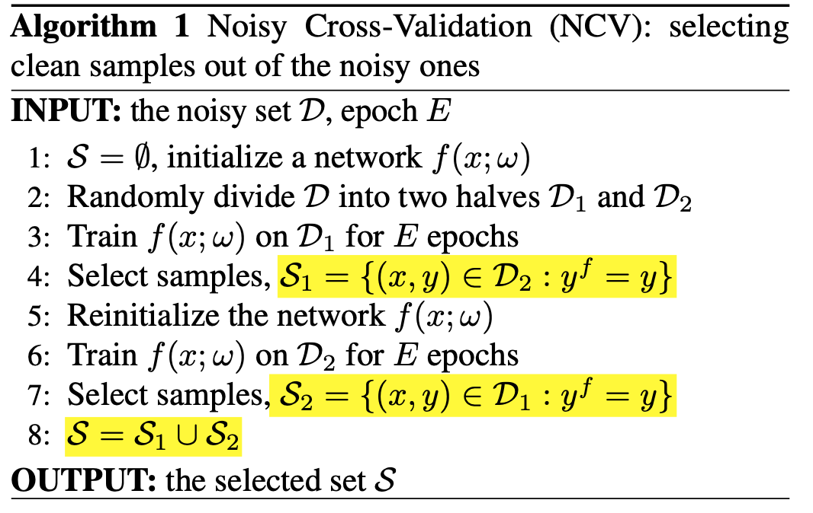
Noisy Cross-Validation (NCV)

Slide 7
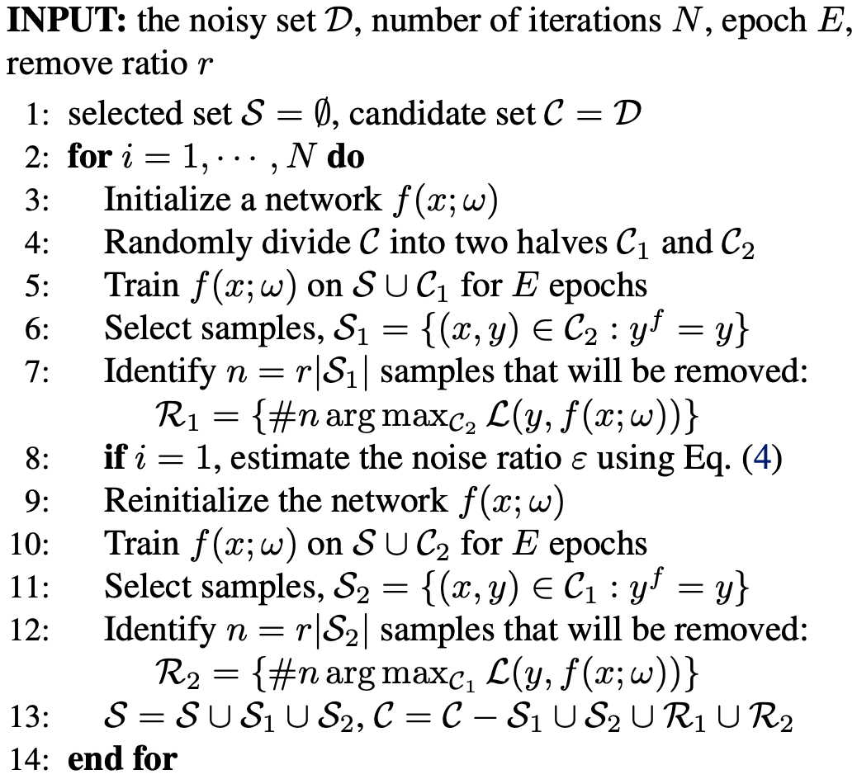
Iterative Noisy Cross-Validation (INCV)
The robust training of DNNs may require larger number of training samples

Slide 8
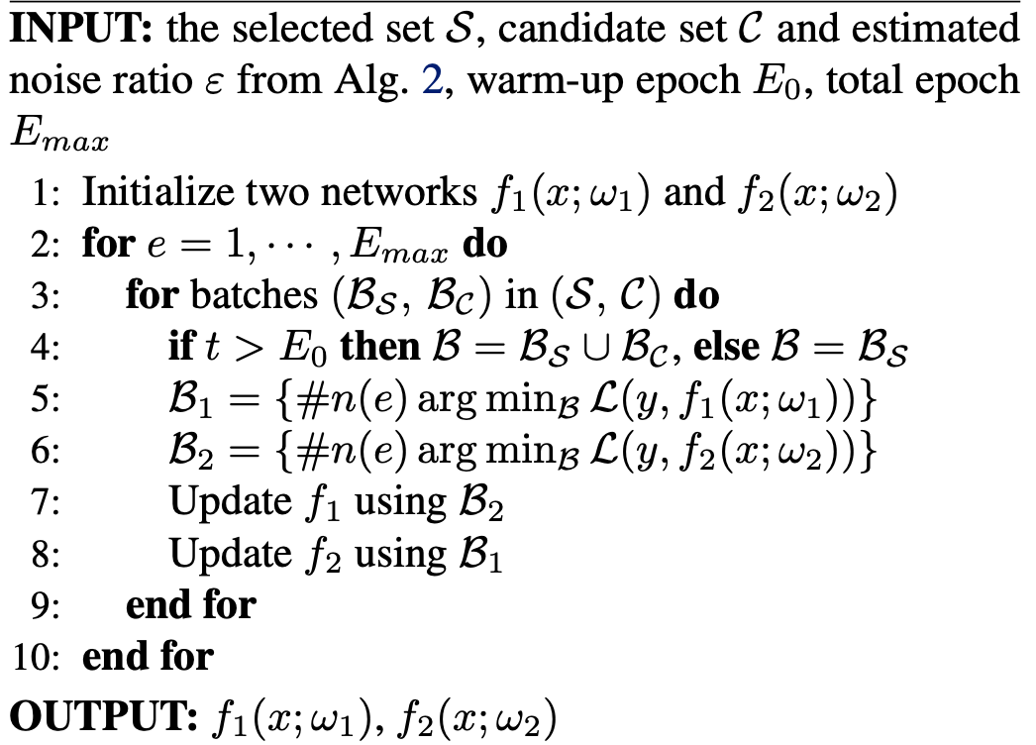
Co-teaching

Slide 9
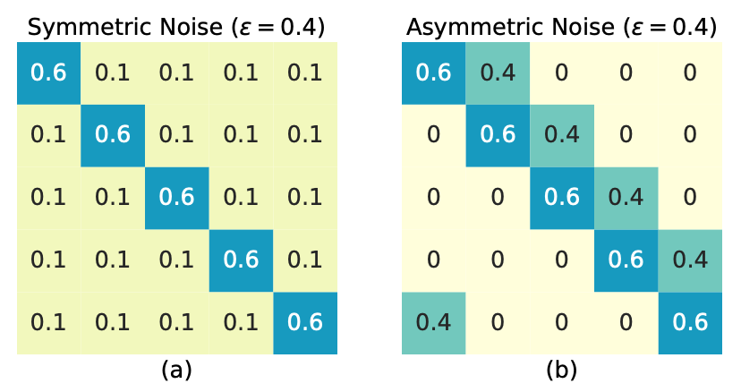
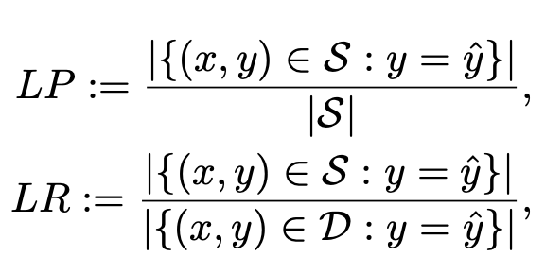
Experiments
Noise
Dataset: Cifar-10, real-world WebVision
Indicator
test accuracy/LP/LR

Slide 10
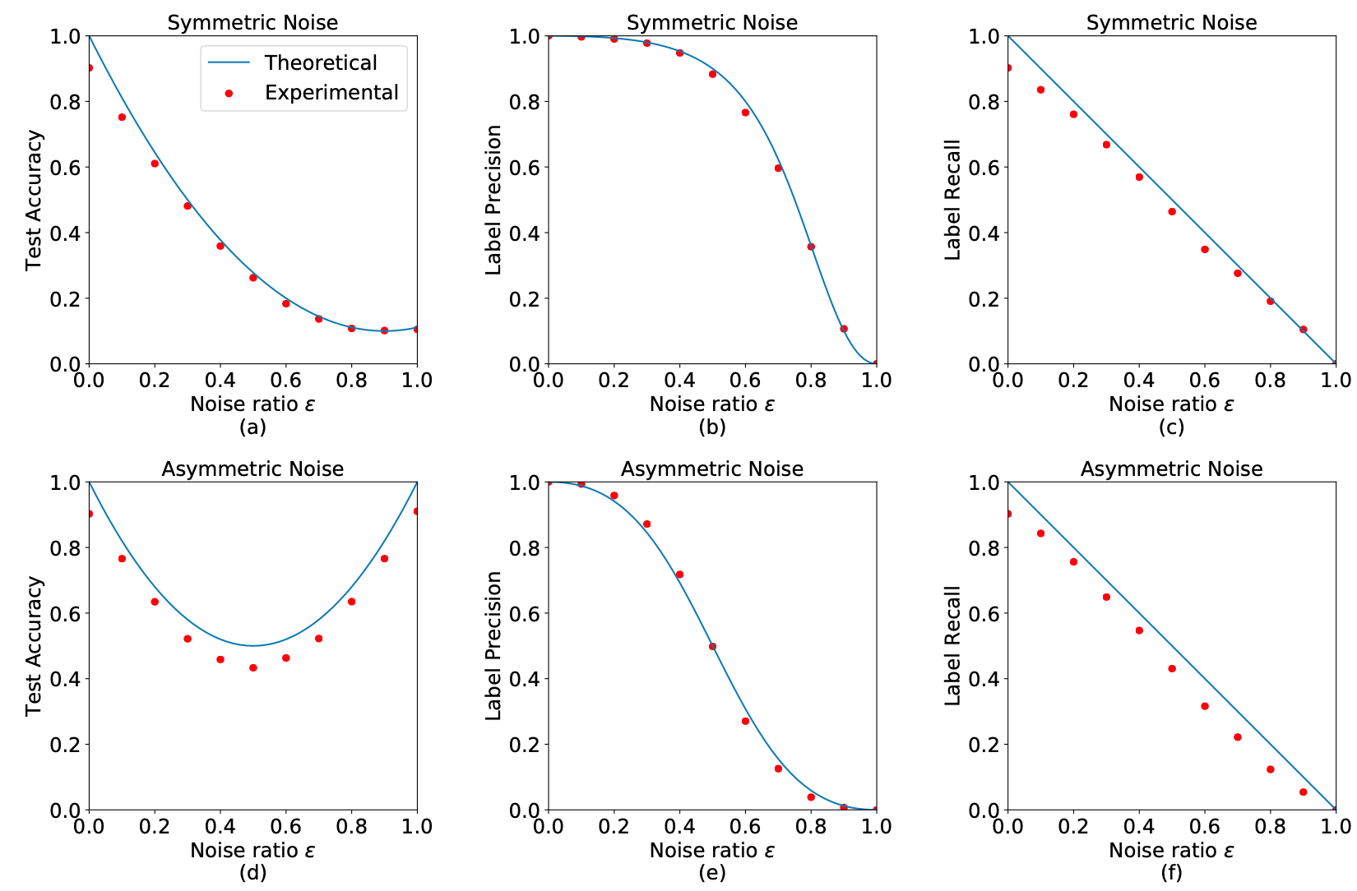
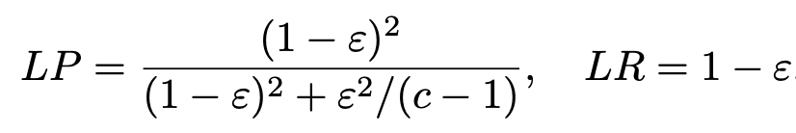
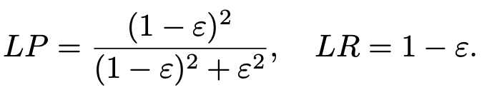
Experimental results confirm the theoretical analysis

Slide 11
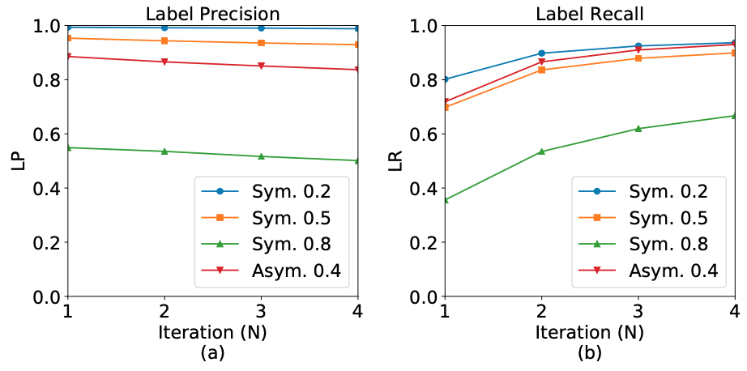
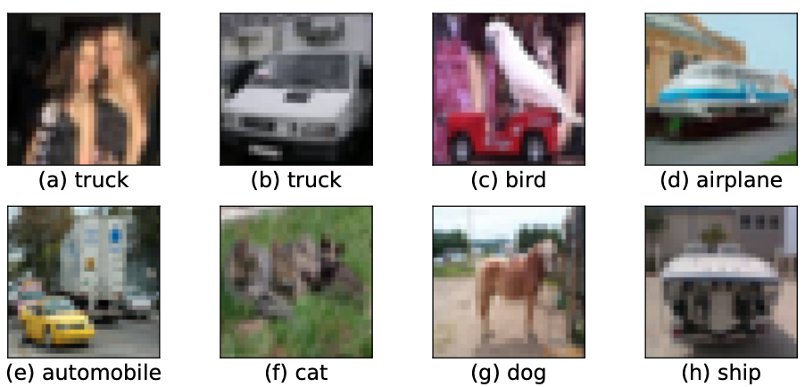
Identifying more clean samples by the INCV
The INCV identifies most clean samples accurately
Noisy labels exist even in the original CIFAR-10

Slide 12
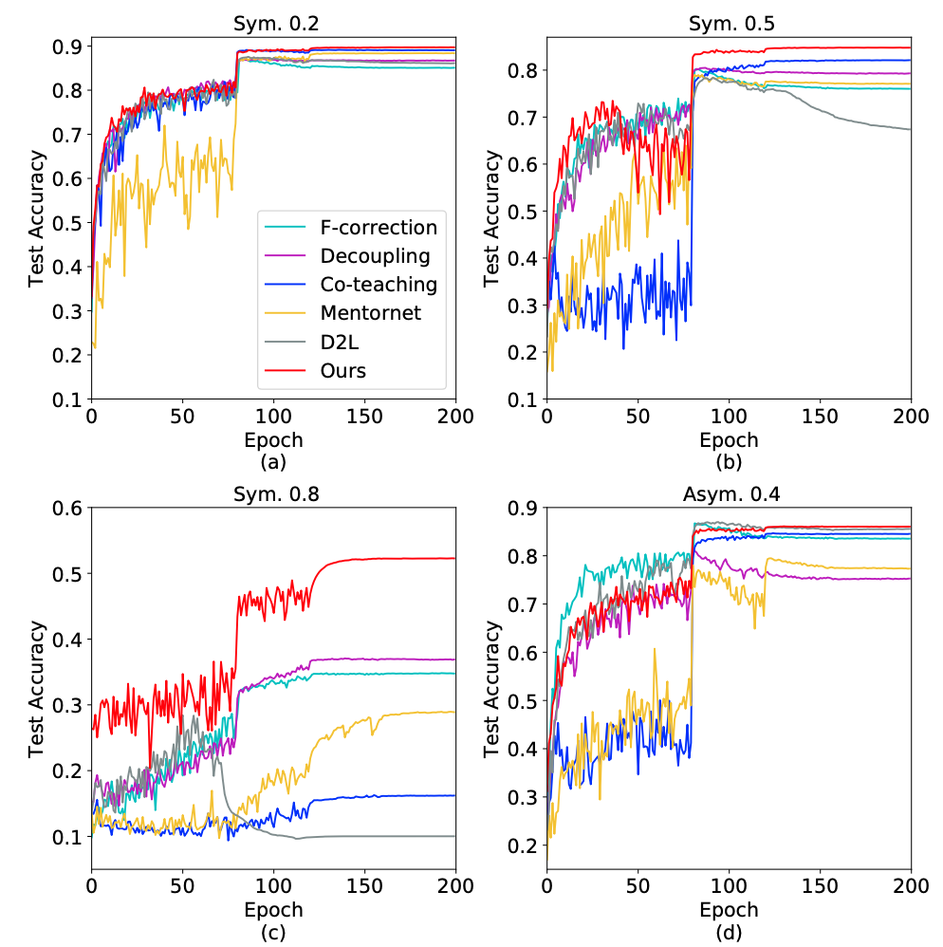
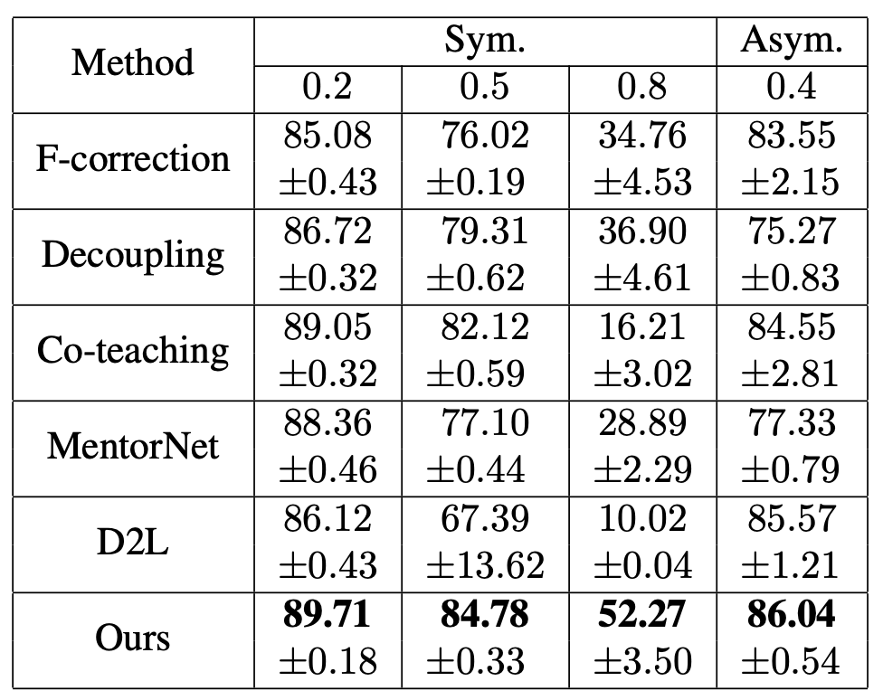
Experiments on manually corrupted CIFAR-10

Slide 13
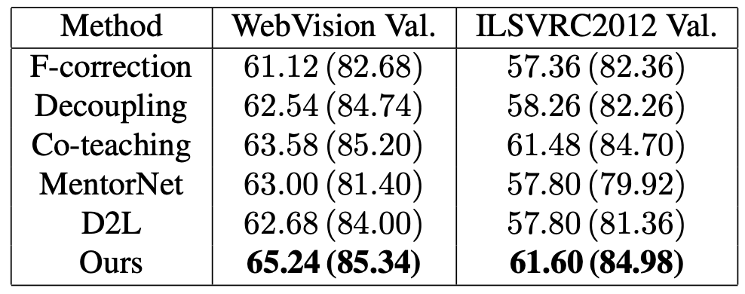
Experiments on real-world noisy labels

Slide 14
Some ideas noted here
CNN
Loss
Feature
Attention
score
feature = F(x; theta)
Attention score alpha = H(feature; w)
Forward(x)
OptimizerStep(loss, (theta, w))
Forward(x)
OptimizerStep(loss, (theta)) Forward(x)
OptimizerStep(loss, (w))
VS
For better interpretability of attention.
How to measure?

Slide 15
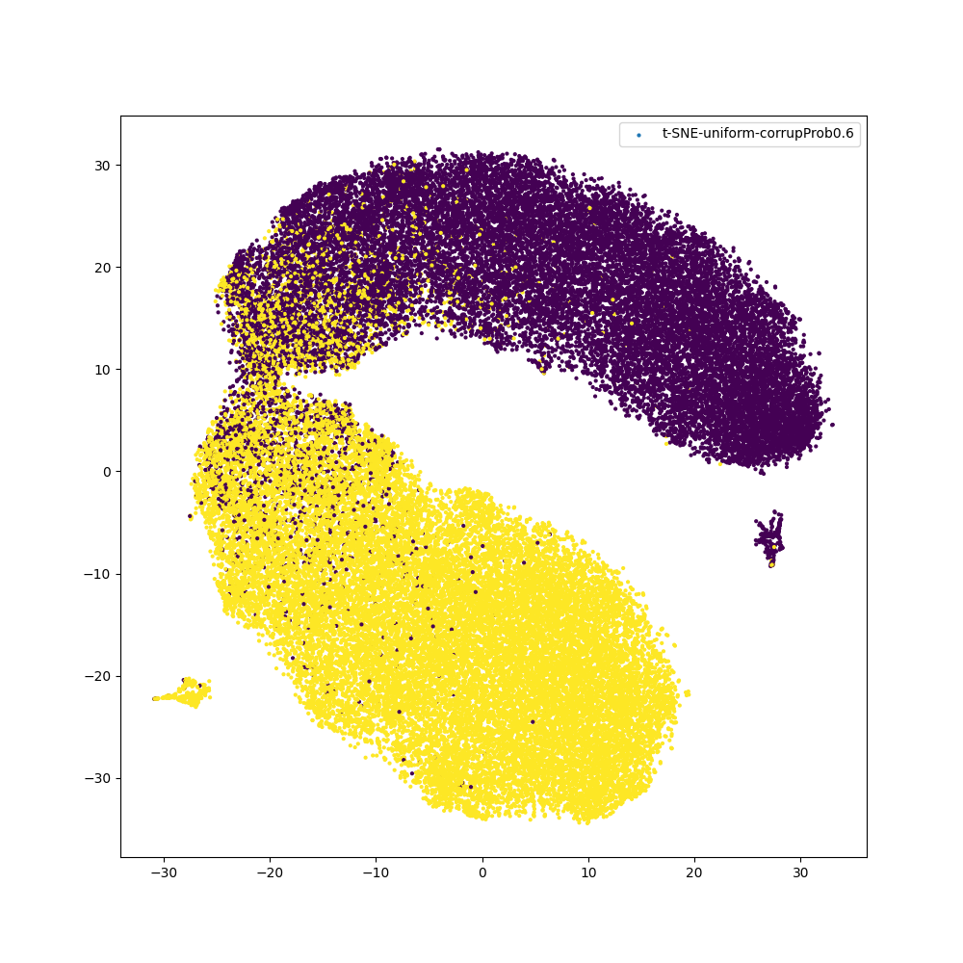
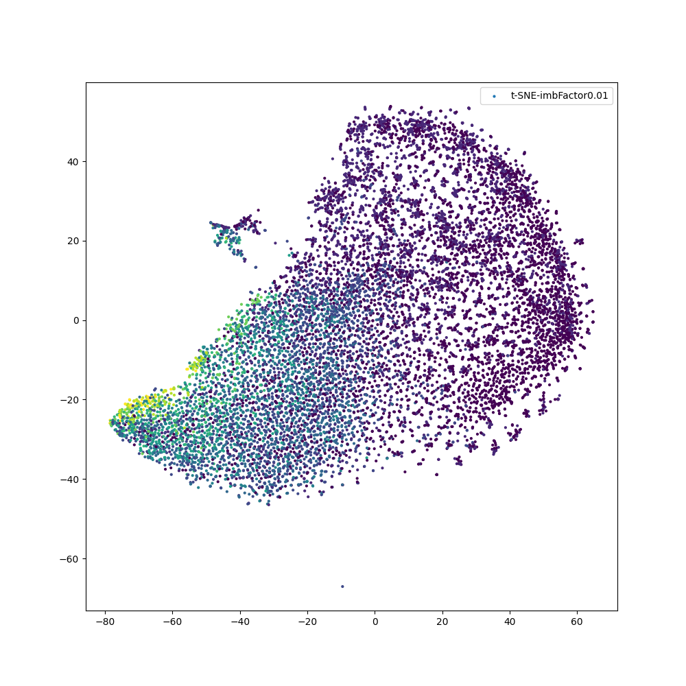
Some ideas noted here
Further investigation for offline prediction sequence
To utilize clustering and representation learning techniques?
To select samples closer to centroid iteratively?
Is there more room in class imbalance which is a
more difficult setting?

